Slide 1

THAKUR SHIV KUMAR SINGH MEMORIAL ENGINEERING COLLEGE BURHANPUR (M.P.)
2021-2022 MINOR PROJECT
ON “The Dream Store
(Get Your Dream Dresses) ”
Bachelor of Technology In Computer science & Engineering
GUIDED BY:- SUBMITTED BY:-
Prof. Yogita Shah Ankita Patil(0884CS191011)
SUBMITTED TO:- Gayatri Bodade(0884CS191029)
Prof. Prithviraj Nikam

Slide 2

“The dream store” ( Get your dream dresses)

Slide 3

CONTENT
Abstract
Introduction
Software Requirement.
Hardware Requirement.
SDLC
Waterfall Model
Flow Chart
E-R diagram
Activity diagram
Class Diagram

Slide 4
Use Case diagram
Sequence Diagram
Data flow diagram
Advantages
Limitations
Conclusion
Future Scope
References

Slide 5
ABSTRACT
The dream store is a platform where an admin can sell their designs and the customer can buy designer dresses at affordable range .A platform where women's who knows stitching can also add their designs and be financially independent . The dream store can provide best material clothes to customer.

Slide 6
INTRODUCTION
The dream store is a buying and selling platform .The main speciality of our website is that a customer can also customize their dresses through direct contact with the designer.
On the website a review page available from where customer can view the feedback of customers.
The more specility that we added in our website it can also count the gst rate after clicking on add to cart button .

Slide 7
SOFTWARE REQUIREMENT
Developer’s:-
Language : PHP
Database : MySql
Server : xampp server
Other Tech : HTML, CSS and JavaScript
IDE : Sublime,VS Code
Web browsers : Mozilla Firefox, Google chrome,
Internet Explorer etc.
Operating system : windows,Linux
User’s:-
Web browsers : Mozilla Firefox, Google chrome
Internet Connection

Slide 8
HARDWARE REQUIREMENT.
Developer’s:-
Processor : 2.20Ghz
RAM : 2 GB(minimum)
Hard disk : 10 GB
User’s:-
RAM : 1 GB
Device : Computers, Mobiles .

Slide 9
SDLC
A software development life cycle (SDLC) model is a conceptual framework.
We are using “Waterfall Model”, which is sequential in nature.
This process is associated with several models, each including a variety of tasks and activities.
SDLC describes all activities in a software development project from planning to maintenance.

Slide 10
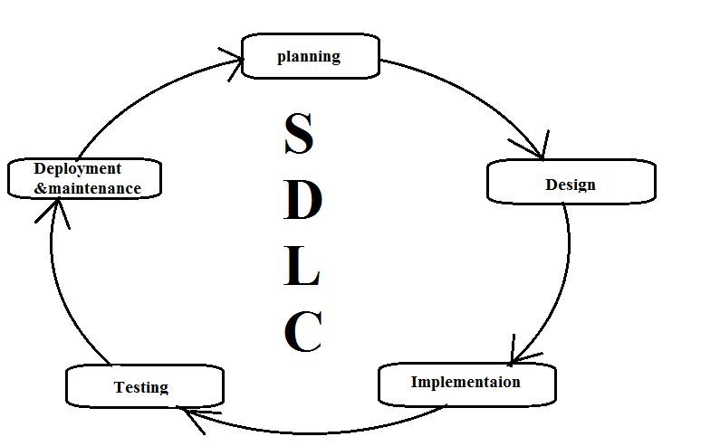
SDLC Activities:-

Slide 11
WATERFALL MODEL
The waterfall model is also known as linear-sequential model.
This model suggest the systematic, sequential approach to the software development.
The software development starts the requirement gathering phase .
Then progresses through analysis, design, coding, testing and maintenance.

Slide 12
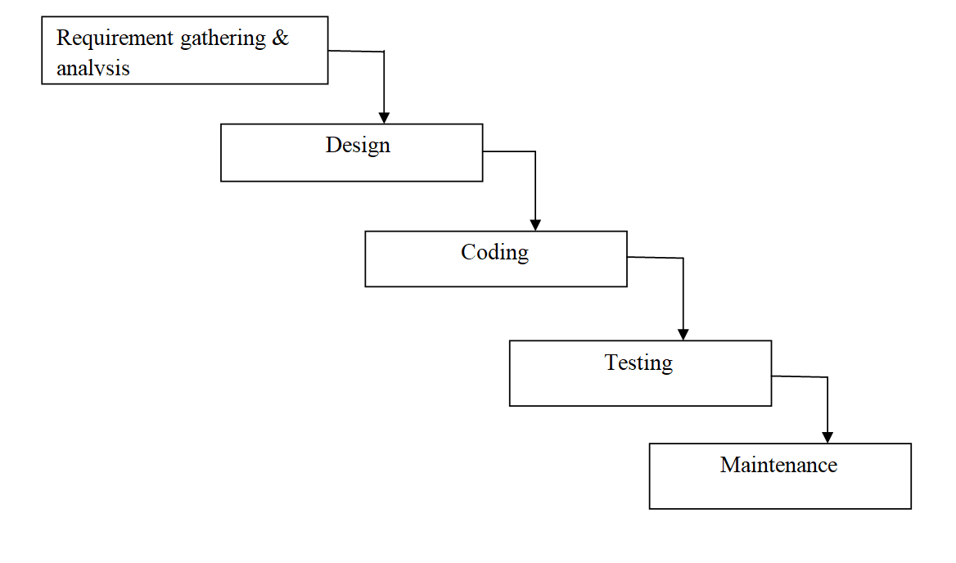
Characteristics of waterfall model:-
Waterfall model is easy to implement.
For implementation of a small system waterfall model is used.

Slide 13
DIAGRAMS

Slide 14
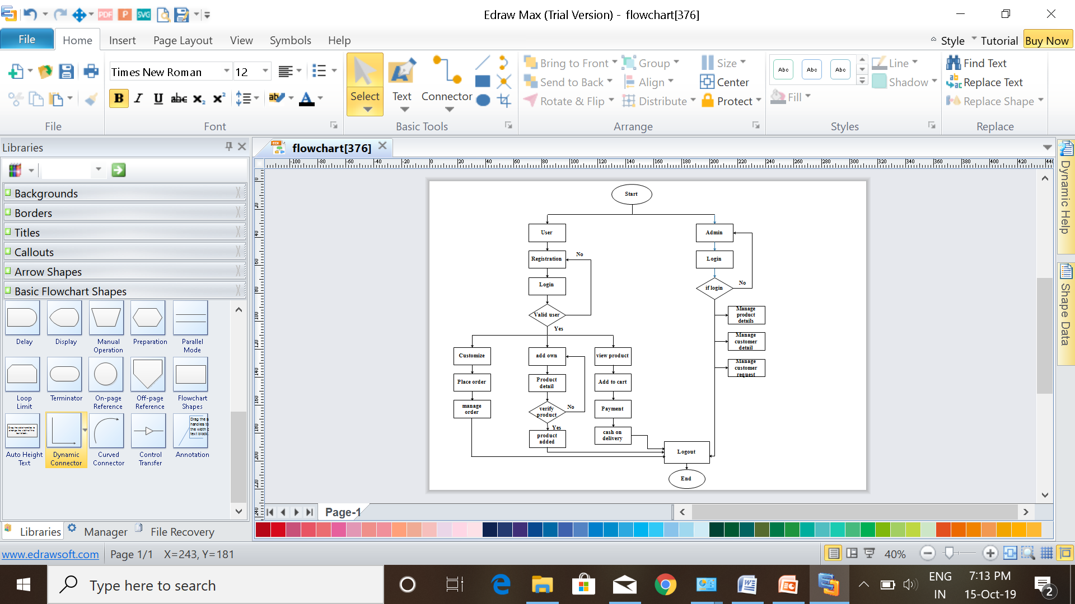
FLOW CHART:-

Slide 15
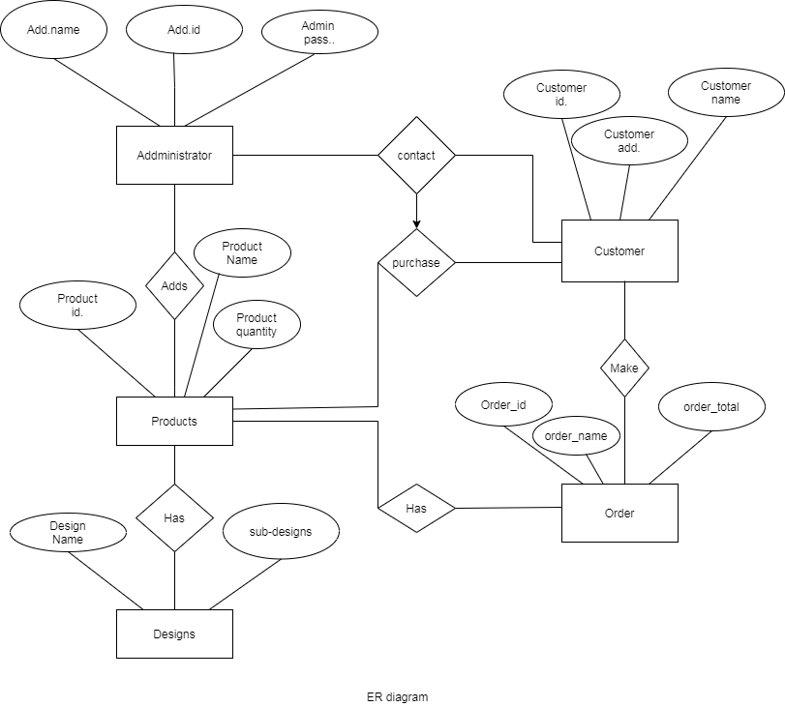
E-R DIAGRAM:-

Slide 16
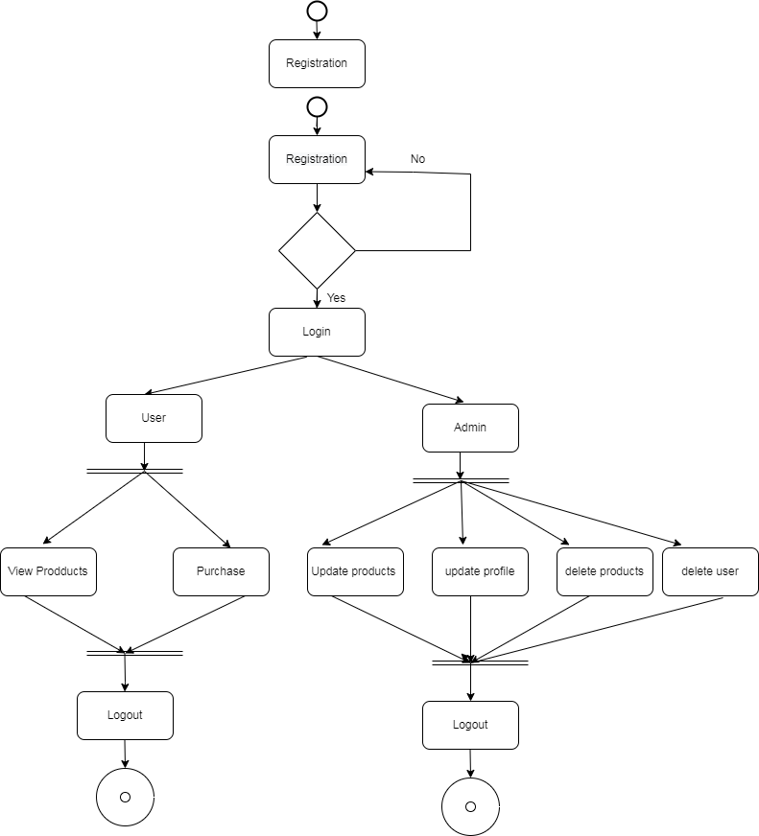
ACTIVITY DIAGRAM:-

Slide 17
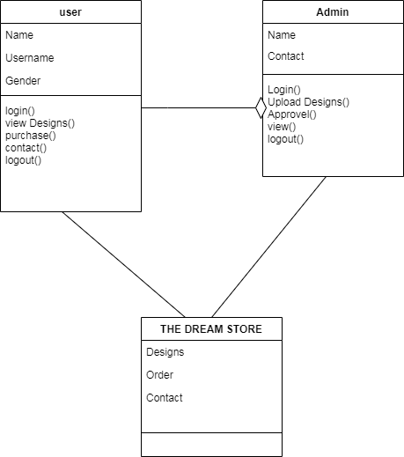
CLASS DIAGRAM:-

Slide 18
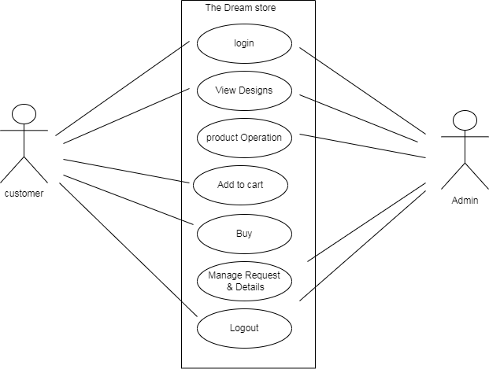
USE CASE DIAGRAM:-

Slide 19
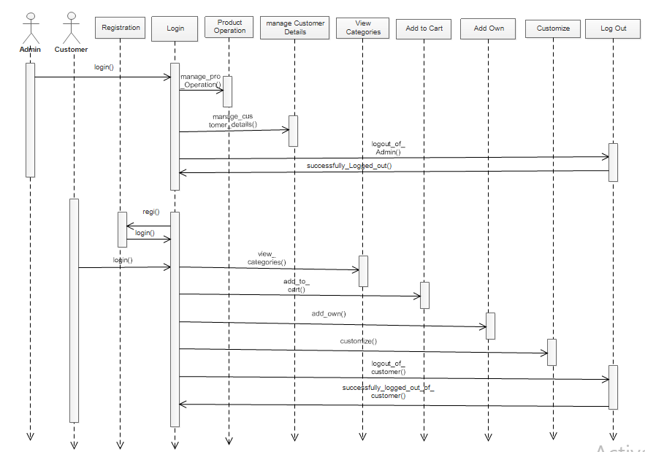
SEQUENCE DIAGRAM:-

Slide 20
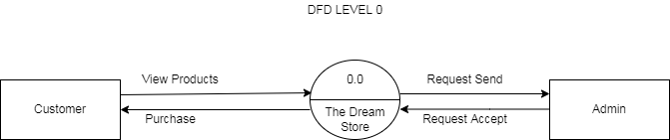
DATA FLOW DIAGRAM:-
DFD level 0:-

Slide 21
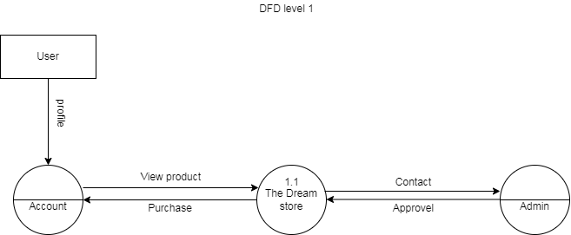
DFD level 1:-

Slide 22
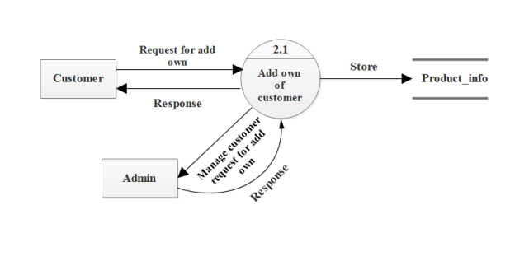
DFD level 2:-

Slide 23
ADVANTAGES
Quality: The best thing about the online tailoring services is that they provide you with the complete quality assurance.
Affordable: As fashion is an important aspect of life. Sometimes, even after paying extra bucks the expectations left unfulfilled. In that case, your money and precious time get wasted.
Low cost: Buying products at reasonable rates.
To provide an online store to buy any type of product anywhere, anytime.
Time Efficient: Previously, we had to wait for a long to get clothes stitched. Just choose an online tailor like “The Dream store” and place your order for the cloth stitching.

Slide 24
LIMITATIONS
No payment gateway is added only cash on delivery.
There is no third party for home delivery.
There is need for internet connection to access the store.
Registration and log-in are required.

Slide 25
FUTURE SCOPE
Many people can earn a living by selling their precious works.
Shops can make their business online under our website.
Skilled people from remote areas as well as all around the world can sell and buy the products.
An online payment gateway can be added.
Deliveries can be managed using a third party.

Slide 26
CONCLUSION
“The Dream Store” provides a way to earn and be financially stable from the comfort of one’s home. People can buy and request for customized products. This project will be efficient and less time consuming. The purpose of this project was to develop a web application. The entire system is secured. This project can be implemented to any nearby shops. It will manage the details of Art, payment, cash, bill, stock. It will maintain or increase the customer’s satisfaction.

Slide 27
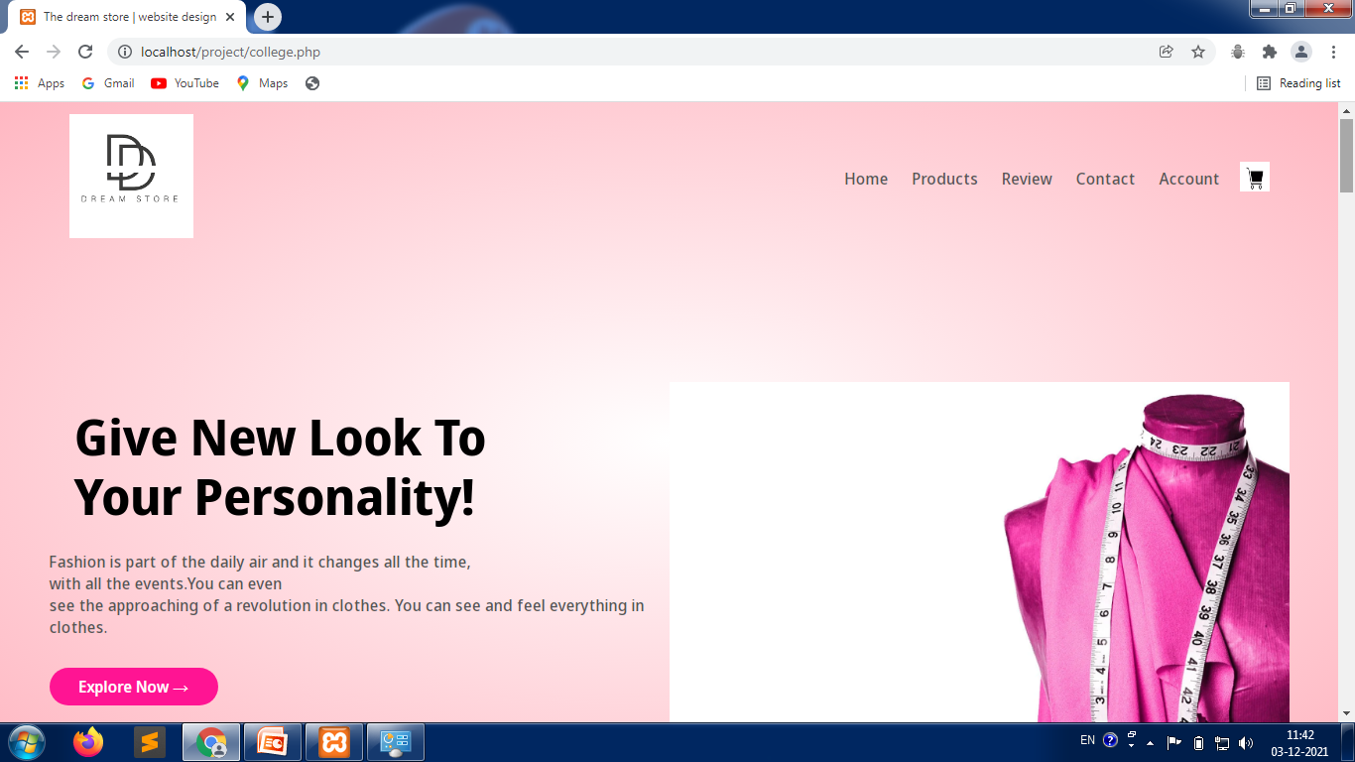
Home Page:-

Slide 28
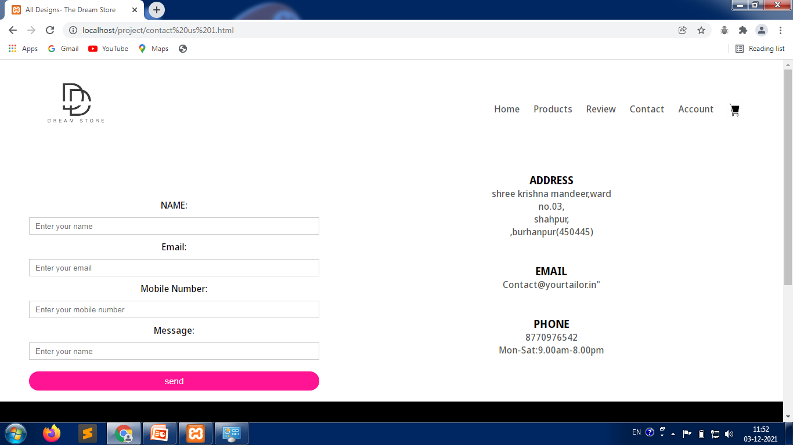
Contact page:-

Slide 29
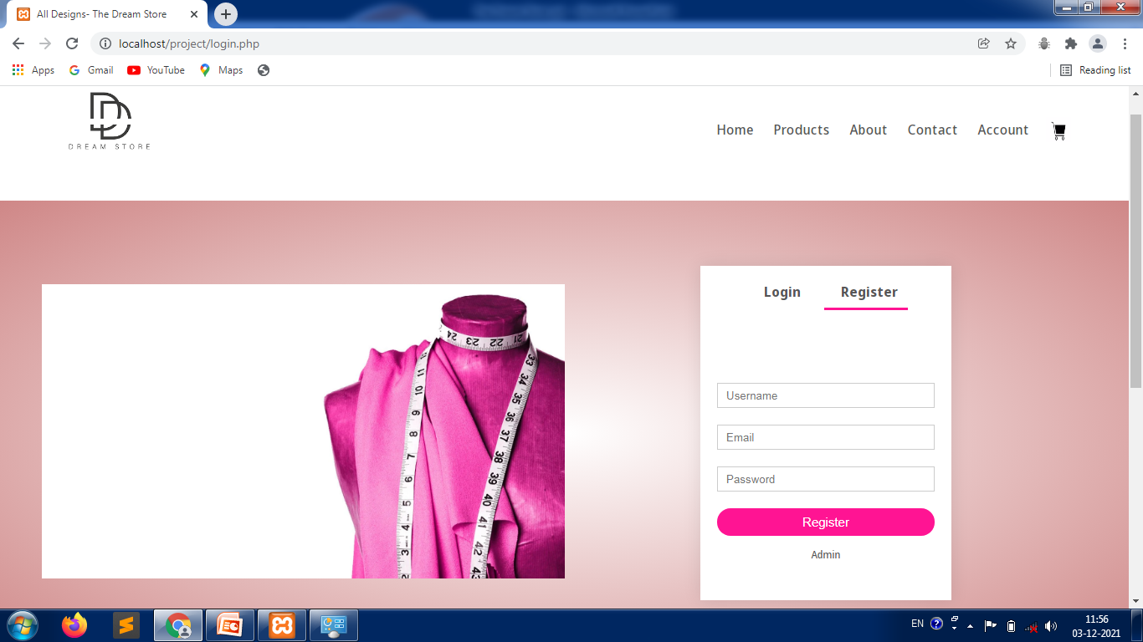
User login page:-

Slide 30
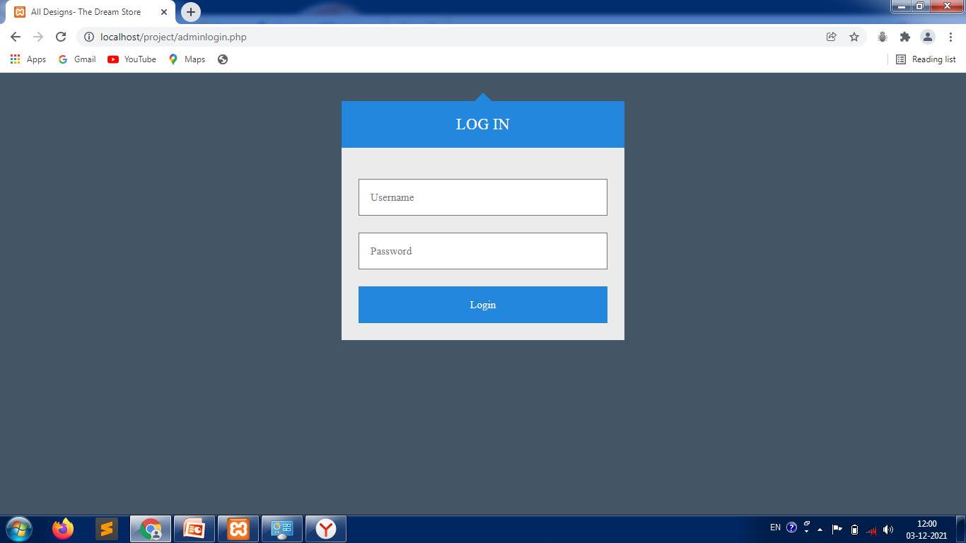
Admin login page:-

Slide 31
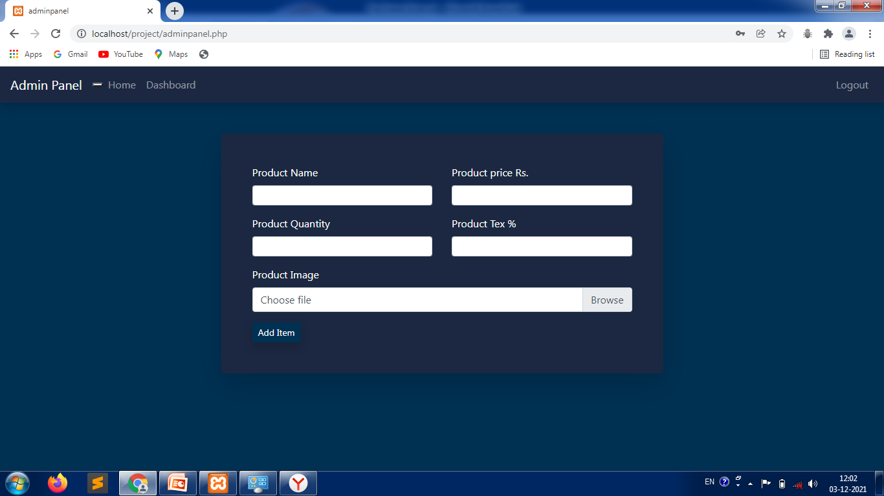
Admin panel for adding designs:-

Slide 32
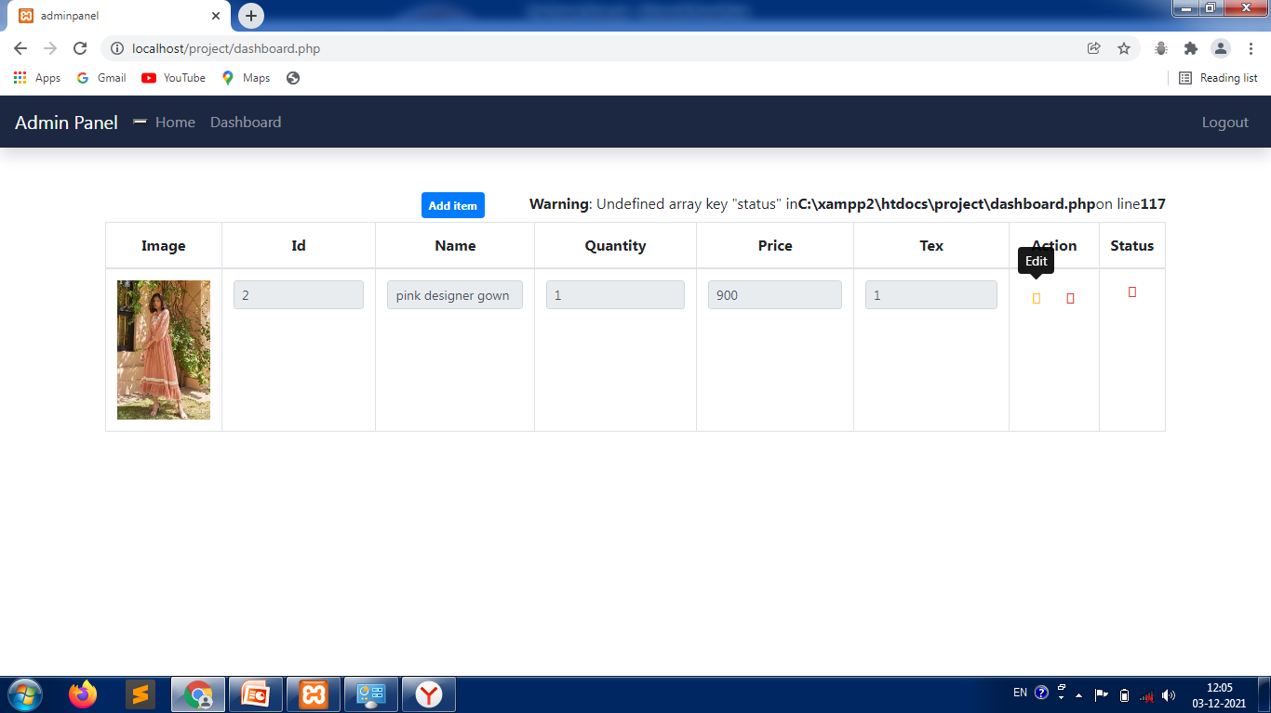
Dashboard:-

Slide 33
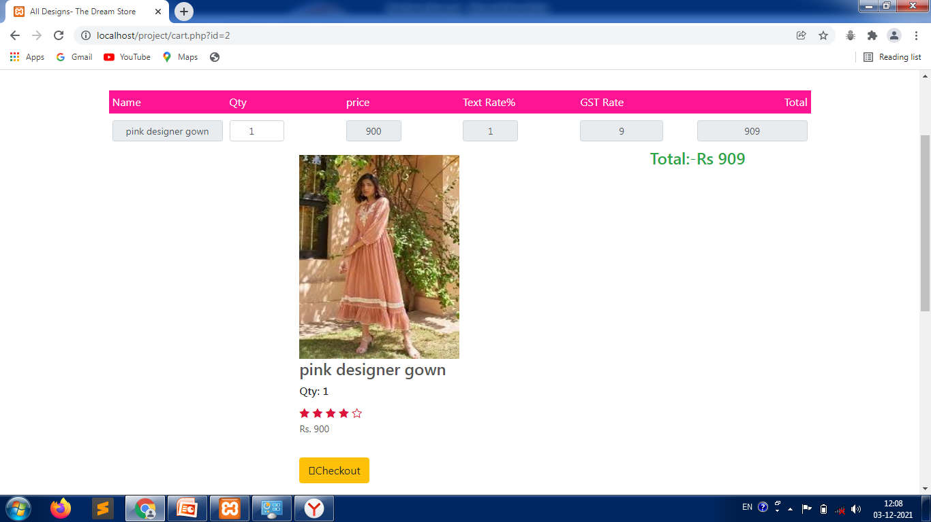
Add to cart:-

Slide 34
REFERENCES
www.w3school.com
https://www.javatpoint.com/
https://stackoverflow.com/

Slide 35
Thank You

Slide 36
Any Queries?

